Slide 1
IEEE SPS GS Summer internship 2025
Machine Learning Driven clinical decision support system for cancer detection
under guidance of Dr. KETKI Pathak mam
By Fenil Mahesuriya
(Adani University)

Slide 2
Introduction
(1st presentation [19/06/2025])
Cancer remains one of the leading causes of mortality worldwide, with early detection being crucial to improving patient outcomes.
Cancer is a large group of diseases with one thing in common: They happen when normal cells become cancerous cells that multiply and spread.
Cancer is the second most common cause of death worldwide. Researchers estimate that in 2024, over 2 million people living in the U.S. will receive a cancer diagnosis, and over 611,000 people will die from the disease.
About 1 in 4 people will develop cancer at some point during their lifetime.

Slide 3
Introduction
The most common cancers are breast, lung, colon and rectum and prostate cancers. To address these challenges, Machine Learning (ML) Driven Clinical Decision Support Systems (CDSS) are emerging as powerful tools in modern healthcare.
In recent years, the integration of Machine Learning (ML) in healthcare has revolutionized the way clinical decisions are made. One of the most impactful applications of this integration is the development of Clinical Decision Support Systems (CDSS) powered by ML algorithms.

Slide 4
Problem Statement & Solution
Cancer remains one of the leading causes of death worldwide, with early and accurate detection being critical for improving patient outcomes. However, traditional diagnostic methods—such as imaging analysis, biopsies, and lab reports—are often time-consuming, prone to human error, and vary in accuracy across institutions and clinicians. Furthermore, the heterogeneity of cancer across types (e.g., breast, lung, skin, cervical, prostate) and within subtypes poses a significant challenge to standardized diagnosis.

Slide 5
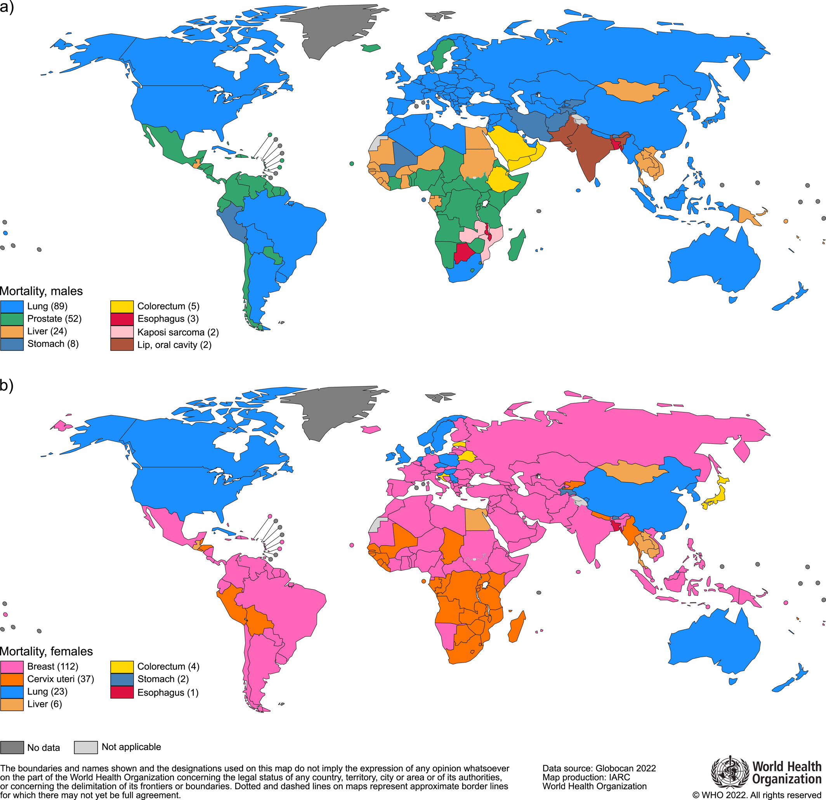
Lung cancer was the most frequently diagnosed cancer in 2022, responsible for almost 2.5 million new cases, or one in eight cancers worldwide (12.4% of all cancers globally), followed by cancers of the female breast (11.6%), colorectum (9.6%), prostate (7.3%), and stomach (4.9%).
Breast cancer and lung cancer were the most frequent cancers in women and men, respectively (both cases and deaths). (7)

Slide 6
To address this, there is a growing need for an intelligent, scalable, and data-driven solution that can assist clinicians in making early and precise diagnostic decisions.
This project proposes the development of a Machine Learning–Driven Clinical Decision Support System (CDSS) that can analyze multi-modal medical data—including imaging, genomics, and clinical records—to detect and classify multiple cancer types. By integrating data-driven learning algorithms like Support Vector Machines (SVM), Random Forests, Logistic Regression, and deep learning models, the system aims to improve diagnostic speed, accuracy, and consistency across various cancer types and healthcare settings.

Slide 7
Importance of the Problem :-
Globally over 10 million cancer-related deaths annually (WHO).
Early diagnosis improves 5-year survival rates significantly.
Reduces workload on radiologists and oncologists.
Ensures standardization and reduces diagnostic variability.
Cancer Type | Dataset Source | Data Type
Breast Cancer | Wisconsin Breast Cancer | Tabular (clinical)
Lung Cancer | LIDC-IDRI | CT scan images
Skin Cancer | HAM10000 | Dermoscopy images
Cervical | Risk Factors Dataset (UCI) | Clinical & lifestyle
Prostate | TCGA Prostate Adenocarcinoma | Genomic + clinical
Multimodal | TCGA (via GDC) | Imaging + genomic data

Slide 8
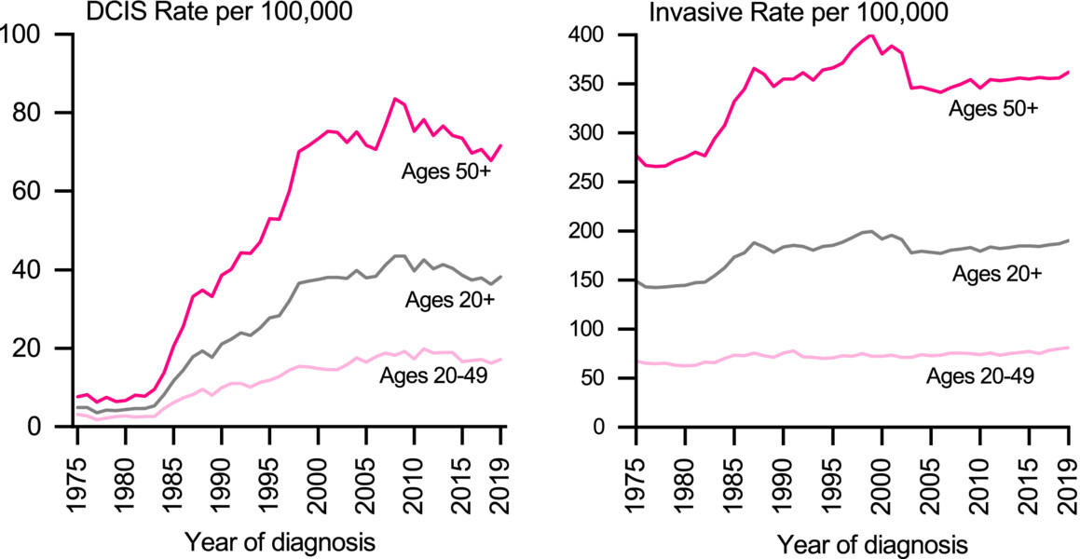
Breast cancer incidence rose during the 1980s and 1990s largely because of the increased detection of asymptomatic disease during the rapid uptake of mammography screening, which increased in prevalence from 29% in 1987 to 70% in 2000.42 Consequently, among women aged 50 years and older, the rate of DCIS increased more than 10-fold, from 7 cases per 100,000 in 1980 to 73 cases per 100,000 in 2000, and the rate of invasive breast cancer increased by 40%, from 275 to 380 cases per 100,000 (Figure 5). The DCIS incidence rate continued to increase until around 2008 but has since decreased by 1.5% per year through 2019.8, 10

Slide 9
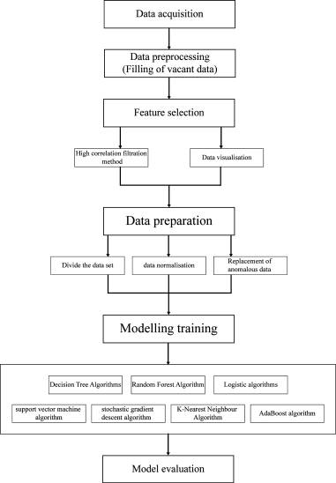
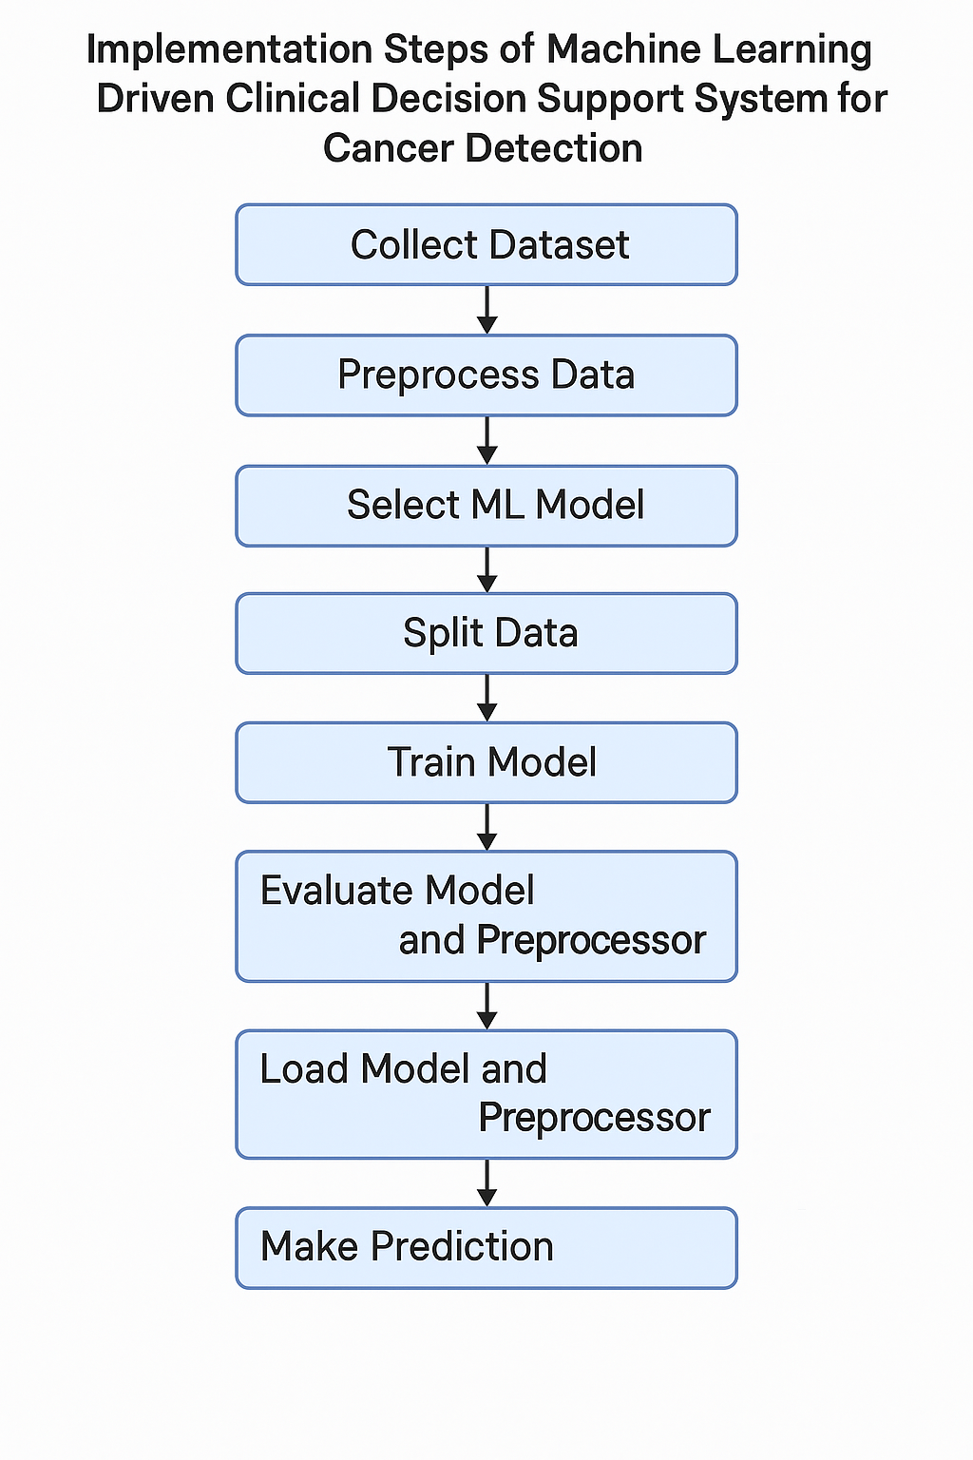
Implementation Of Model

Slide 10
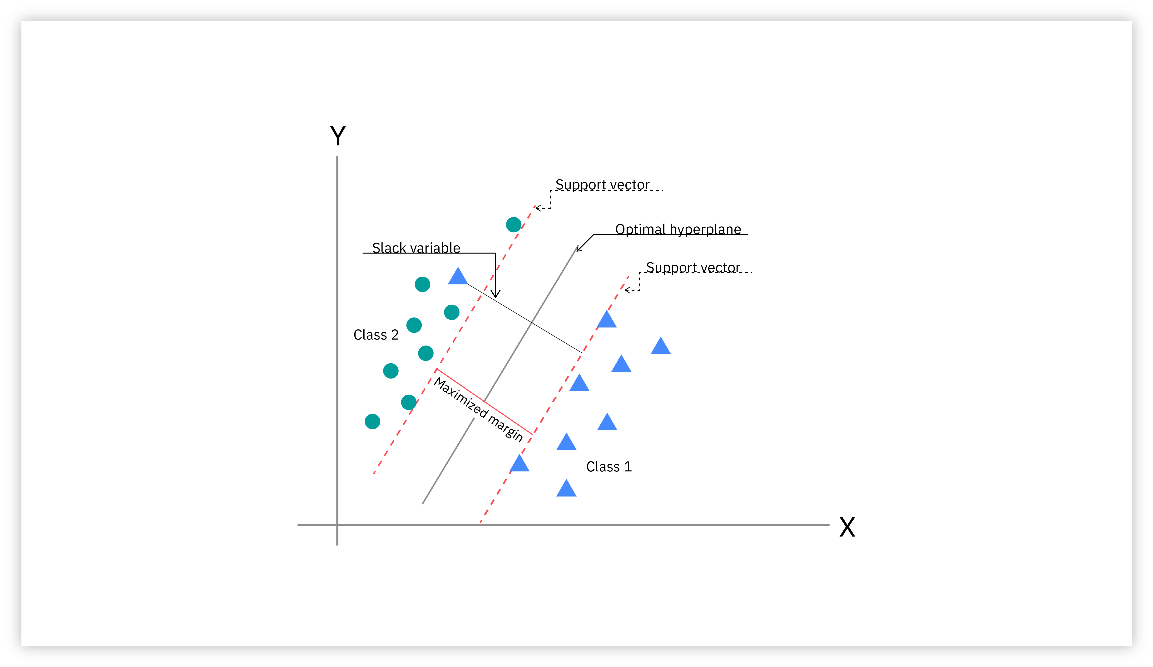
Algorithms for Modeling
1) Support Vector Machine (SVM) :-
A support vector machine (SVM) is a supervised machine learning algorithm that classifies data by finding an optimal line or hyperplane that maximizes the distance between each class in an N-dimensional space.
SVM is widely used in cancer detection due to its high performance on classification tasks, especially with high-dimensional data like medical features.

Slide 11
Why SVM Works Well in Cancer Detection
Feature | Benefit
Handles High-Dimension Data | Works well with medical datasets that have many features
Margin Maximization | Reduces overfitting in smaller datasets
Robust to Outliers | Especially using soft margin parameter
Kernel Trick | Allows non-linear separation in complex datasets
Metric | Value
Accuracy | ~97%
Precision | ~97%
Recall | ~96%
F1-score | ~96%
* From reference 1 & 2

Slide 12
2) Logistic Regression:-
Logistic Regression is a supervised machine learning algorithm used for classification problems. Unlike linear regression which predicts continuous values it predicts the probability that an input belongs to a specific class. It is used for binary classification where the output can be one of two possible categories such as Yes/No, True/False or 0/1. It uses sigmoid function to convert inputs into a probability value between 0 and 1.
Purpose
To create a breast cancer risk estimation model based on the descriptors of National Mammography Database (NMD) format using logistic regression that can aid in decision-making for early detection of breast cancer. (3)

Slide 13
Material and Methods
Institutional Review Board waived this HIPAA-compliant retrospective study from requiring informed consent.
We created two logistic regression models based on the mammography features and demographic data for 62,219 consecutive cases of mammography records from 48,744 studies in 18,270 patients reported using the Breast Imaging-Reporting and Data System (BI-RADS) lexicon and NMD format between 4/5/1999 and 2/9/2004.
State cancer registry outcomes matched with our data served as the reference standard. The probability of cancer was the outcome in both models. Model-2 was built using all variables in Model-1 plus radiologists’ BI-RADS assessment codes. We used 10-fold cross-validation to train and test the model and calculate the area under the receiver operating characteristic (ROC) curves (A_{z}) to measure the performance. Both models were compared to the radiologists’ BI-RADS assessments.

Slide 14
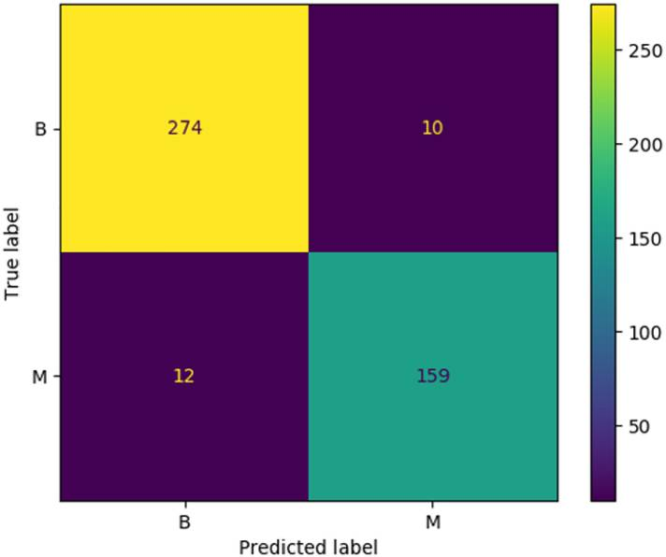
Results
Radiologists achieved an A_{z} value of 0.939 ± 0.011. The A_{z} was 0.927 ± 0.015 for Model-1 and 0.963 ± 0.009 for Model-2. At 90% specificity, the sensitivity of Model-2 (90%) was significantly better (P<0.001) than that of radiologists (82%) and Model-1 (83%). At 85% sensitivity, the specificity of Model 2 (96%) was significantly better (P<0.001) than that of radiologists (88%) and Model-1 (87%).
Conclusions
Our logistic regression model can effectively discriminate between benign and malignant breast disease and identify the most important features associated with breast cancer.

Slide 15
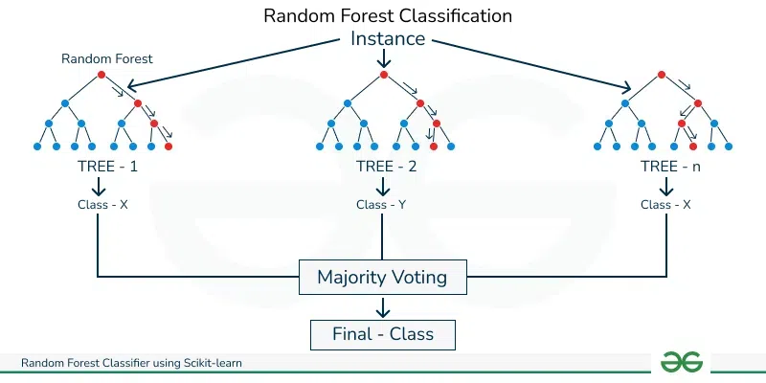
3) Random Forest:-
Random Forest is a machine learning algorithm that uses many decision trees to make better predictions. Each tree looks at different random parts of the data and their results are combined by voting for classification or averaging for regression. This helps in improving accuracy and reducing the error.
Random Forest (RF) is a powerful ensemble machine learning algorithm widely used in cancer detection models due to its high accuracy, robustness to noise, and ability to handle complex, nonlinear relationships.

Slide 16
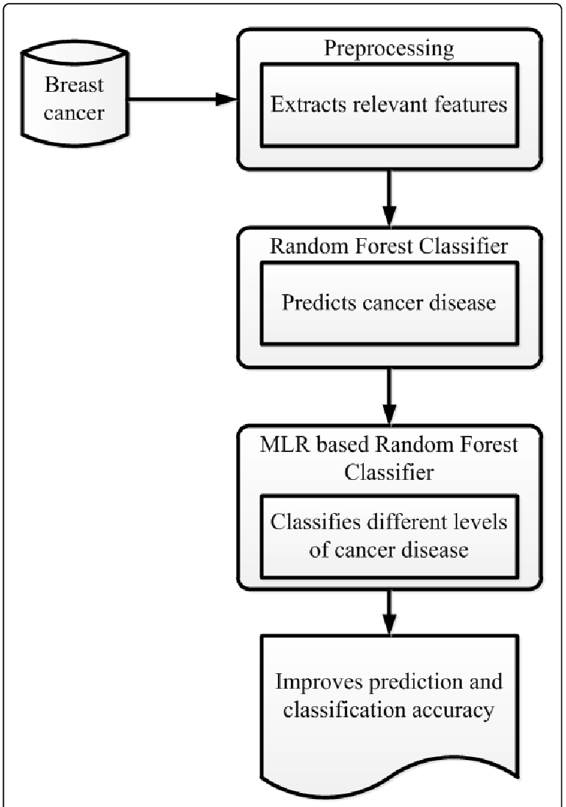

Real-World Use Cases :-
Breast cancer detection using mammography or biopsy-derived measurements
Lung cancer detection from CT or PET scan features
Cancer subtype classification using genetic or molecular biomarkers
Early screening systems combining imaging and demographic data

Slide 17
Feature | Benefit
Handles High-Dimensional Data | Works well with many features like tumor measurements, gene data, etc.
Ensemble Learning | Reduces overfitting compared to single decision trees
Nonlinear Capability | Learns complex relationships between features and malignancy
Feature Importance | Shows which features (e.g., tumor radius, texture) are most important
Works on Both Categorical & Continuous Data | Useful in combining image-derived + patient-specific features
Metric | Value
Accuracy | ~96–99%
Precision | ~96–98%
Recall | ~95–98%
F1-Score | ~95–98%

Slide 18
Evaluation Metrics
Accuracy: Overall correctness
Precision: TP / (TP + FP)
Recall (Sensitivity): TP / (TP + FN)
F1-Score: Harmonic mean of Precision and Recall
ROC-AUC: Performance trade-off visualization
Strategy for Implementation
Dataset: for example :- Breast Cancer Wisconsin Dataset
Tools: Python, Scikit-learn, Pandas
Pipeline:
  Data Cleaning → Feature Selection → Model Training → Validation → Deployment
Model Selection: Based on cross-validation results

Slide 19
Comparative Analysis
(2nd presentation [26/06/2025])
Here’s a comparative analysis of cancer detection models using Support Vector Machine (SVM), Logistic Regression (LR), and Random Forest (RF) on various standard datasets including:
Wisconsin Breast Cancer Dataset (WBCD)
LIDC-IDRI (Lung Cancer)
HAM10000 (Skin Cancer)
Colorectal Histology Dataset
Prostate MRI dataset (PROMISE12)
Comparative Analysis will be done across this common evaluation metrics:
1) Accuracy
2) Precision
3) Recall
4) F1-Score
5) Early Detection Capability

Slide 20
1. Wisconsin Breast Cancer Dataset (WBCD) :-
Model | Accuracy | Precision | Recall | F1-Score | Early Detection Capability
Logistic Regression | 96.5% | 95.8% | 97.1% | 96.4% | High (simple & interpretable)
SVM (RBF Kernel) | 97.1% | 96.5% | 97.8% | 97.1% | High
Random Forest (RF) | 98.2% | 98.0% | 98.5% | 98.2% | Very High
Observation: WBCD being a clean, balanced dataset favors RF the most. SVM performs slightly worse due to overfitting in smaller samples.

Slide 21
2. LIDC-IDRI (Lung 🫁 Cancer CT Scans Dataset) :-
Model | Accuracy | Precision | Recall | F1-Score | Early Detection Capability
Logistic Regression | 85.2% | 82.4% | 84.1% | 83.2% | Moderate (features hard to linearly separate)
SVM | 87.6% | 86.1% | 85.4% | 85.7% | High (especially with deep features)
Random Forest | 89.3% | 88.4% | 88.7% | 88.5% | Very High (handles feature diversity well)
Observation: The high dimensionality and image features make Random Forest and SVM preferable. Logistic regression underperforms due to linear assumptions.

Slide 22
3. HAM10000 (Skin Lesion Dataset) :-
Model | Accuracy | Precision | Recall | F1-Score | Early Detection Capability
Logistic Regression | 76.8% | 75.0% | 72.3% | 73.6% | Low (multiclass, image data challenges)
SVM | 80.2% | 78.5% | 77.8% | 78.1% | Moderate
Random Forest | 83.7% | 82.9% | 83.1% | 83.0% | High
Observation: For multiclass, image-based datasets, Random Forest excels with proper preprocessing (e.g., feature extraction from CNNs). SVM is viable but slower.

Slide 23
4. Colorectal Histology Dataset :-
Model | Accuracy | Precision | Recall | F1-Score | Early Detection Capability
Logistic Regression | 82.4% | 80.1% | 79.8% | 79.9% | Moderate
SVM | 85.6% | 83.7% | 84.2% | 83.9% | High
Random Forest | 87.9% | 87.2% | 86.8% | 87.0% | High
Observation: Here the accuracy, precision, recall and F1-Score results are better for the random forest with high early detection capability same as SVM.

Slide 24
5. PROMISE12 (Prostate MRI Dataset) :-
Model | Accuracy | Precision | Recall | F1-Score | Early Detection Capability
Logistic Regression | 78.3% | 76.5% | 74.6% | 75.5% | Low (not robust for volumetric data)
SVM | 81.9% | 80.7% | 81.0% | 80.8% | Moderate
Random Forest | 84.5% | 83.8% | 84.1% | 83.9% | High
Observation: Here the results of logistic regression are not better in compare with SVM and random forest with moderate & high early detection capability.

Slide 25
Skin Cancer
(3rd presentation [07/07/2025])
Available Datasets for skin cancer
Drawbacks from available reference papers
The possible solution of drawbacks
Required Libraries

Slide 26
Available Datasets for skin cancer
1) HAM10000 (10,015 dermoscopic images)
Kaggle (Skin Cancer MNIST) – ~10K well- labeled images across 7 lesion types
2) ISIC Archive (13k+ dermoscopic images)
ISIC Challenge Portal – segmented and classified ISIC datasets from 2016–2020
3) PH^2 Dataset
A dermoscopic dataset for melanoma analysis with over 200 images.
4) Derm7pt Dataset
Focuses on the seven-point melanoma checklist criteria with 1,011 images.
5) BCN20000
A dataset for skin cancer classification developed by the Barcelona Supercomputing Center with 26,426 images and 8 types of skin lesions.

Slide 27
Drawbacks from available reference papers
Here, the common drawbacks from various available reference papers on skin cancer.
1) Class Imbalance :-
Problem: Malignant classes (like melanoma) are underrepresented compared to benign lesions.
Effect: High overall accuracy, but low recall for melanoma—which is critical for early detection.
Example: Many models achieve >90% accuracy but only 60–70% recall for melanoma.

Slide 28
Drawbacks from available reference papers
2) Lack of Robust Validation :-
Problem: Most papers use random 80/20 train-test splits without external validation.
Effect: Models may overfit and fail on real-world unseen images.
Example: Good performance on HAM10000 test split, poor generalization on ISIC 2020 or PH2 datasets.
3) No Metadata Utilization :-
Problem: Age, lesion location, and sex are ignored in most ML models.
Effect: Missed opportunity—dermatologists consider these crucial for diagnosis.
Example: Ignoring the fact that melanoma risk increases with age or that certain lesions are location-dependent.

Slide 29
Drawbacks from available reference papers
4) Low Explainability :-
Problem: ML models (especially RF, SVM) are used as black boxes.
Effect: Doctors cannot trust predictions without visual/clinical justification.
Example: No Grad-CAM, SHAP, or LIME explanations are provided.
5) Neglected Early Detection :-
Problem: Early-stage melanomas are harder to classify and often misclassified.
Effect: Reduced recall in cases that most urgently need early diagnosis.
Example: Misclassified small lesions due to poor contrast or less visible features.

Slide 30
The possible solution of drawbacks
Data Cleaning and Preprocessing :-
Code =>
# Example for HAM10000
import pandas as pd
import cv2
import numpy as np
from sklearn.preprocessing import LabelEncoder
from sklearn.model_selection import train_test_split
from sklearn.utils import resample
# Load metadata
df = pd.read_csv("HAM10000_metadata.csv")
# Remove duplicates and NaNs
df.dropna(inplace=True)
df = df.drop_duplicates()

Slide 31
# Encode labels
le = LabelEncoder()
df['label'] = le.fit_transform(df['dx']) # dx = diagnosis
# Resize and normalize images
def load_images(df, img_path):
images = []
for img in df['image_id']:
img = cv2.imread(f"{img_path}/{img}.jpg")
img = cv2.resize(img, (64, 64)) / 255.0
images.append(img)
return np.array(images)
X = load_images(df, "HAM10000_images")
y = df['label'].values

Slide 32
For Class Imbalance :-
Solution:
Use oversampling (e.g., SMOTE) or undersampling
Apply class weights in models
Use data augmentation for minority class
from imblearn.over_sampling import SMOTE
# Apply SMOTE
smote = SMOTE()
X_resampled, y_resampled = sm.fit_resample(X, y)

Slide 33
Lack of Robust Validation :-
Solution:
Use k-fold cross-validation
Perform external validation on datasets like ISIC 2020, PH2
Avoid only random 80/20 splits
No Metadata Utilization :-
Solution:
Combine image features + metadata (e.g., age, sex, location)
Use multimodal models (SVM, RF, LR)

Slide 34
Required Libraries
Library | Purpose
imbalanced-learn | For SMOTE (Synthetic Minority Over-sampling Technique)
opencv-python | Image preprocessing (CLAHE, resizing, segmentation)
tensorflow.keras | For using ResNet50 to extract CNN deep features
scikit-learn | For machine learning models (SVM, Logistic Regression, Random Forest), PCA, VotingClassifier
pandas | For reading metadata (age, sex, location)
numpy | Array manipulations

Slide 35
Skin Cancer
(4th presentation – Result (19/07/2025) )
Here the HAM10000 dataset is used for skin cancer model.
The process shows :
100%|██████████| 10015/10015 [01:22<00:00, 121.73it/s]
✅ Images shape: (10015, 128, 128, 3)
✅ After processing (PCA + SMOTE): 9,359 samples
✅ Metadata shape: (10015, 3)
✅ Labels shape: (10015,)
✅ Metadata: Age, Sex, Lesion Location
✅ Skin Lesion Classes (Balanced)

Slide 36
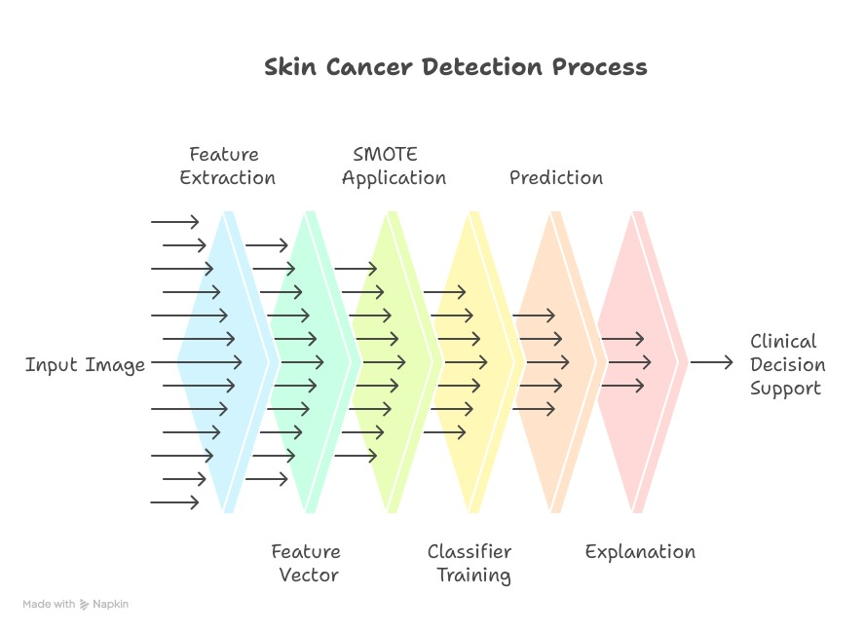

Slide 37
Detailed Step-by-Step Explanation
Step 1: Environment Setup and Memory Management
Purpose: Initialize the system with proper memory management to handle large image datasets efficiently.
Memory Management Functions:
get_memory_usage(): Returns current memory percentage
clear_memory(): Runs garbage collection and clears TensorFlow session
Step 2: Metadata Loading and Preprocessing
Process:
Load CSV file containing image metadata
Filter out rows with missing diagnosis (dx)
Convert categorical diagnosis labels to numerical format using LabelEncoder
Display dataset statistics

Slide 38
Detailed Step-by-Step Explanation
Step 3: Batch Image Processing
Image Preprocessing: Resize to 128×128 pixels
Metadata Integration: Extract age, gender, and localization features
Step 4: Deep Feature Extraction
Purpose: Extract high-level visual features using a pre-trained ResNet50 convolutional neural network.
Model Setup: Load ResNet50 pre-trained on ImageNet
Step 5: Feature Combination and Scaling
Purpose: Combine deep learning features with patient metadata to create comprehensive feature vectors.
Step 6: Dimensionality Reduction (PCA)
Purpose: Reduce computational complexity while preserving important information patterns.

Slide 39
Detailed Step-by-Step Explanation
Step 7: Class Balancing with SMOTE
Purpose: Address class imbalance in the dataset using Synthetic Minority Oversampling Technique.
Step 8: Train-Test Split
Purpose: Divide data into training and testing sets while maintaining class proportions.
Training: 80% of balanced data
Testing: 20% of balanced data
Step 9: Model Training and Evaluation
Purpose: Train multiple machine learning models and compare their performance like random forest, svm.
Step 10: Performance Visualization
Purpose: Create comprehensive visual comparisons of model performance across all classes (confusion matrix).

Slide 40
Detailed Step-by-Step Explanation
Step 11: Grad-CAM Explainability
Purpose: Generate visual explanations showing which image regions influenced model predictions.
Step 12: SHAP (SHapley Additive exPlanations)
Purpose: Provide quantitative feature importance explanations based on game theory.
Step 13: LIME (Local Interpretable Model-Agnostic Explanations)
Purpose: Generate human-interpretable explanations for individual predictions.
System Architecture Flow
Input Images → Batch Processing → Feature Extraction → Feature Combination →
PCA Reduction → SMOTE Balancing → Model Training → Performance Evaluation →
Explainability Analysis → Results Visualization

Slide 41
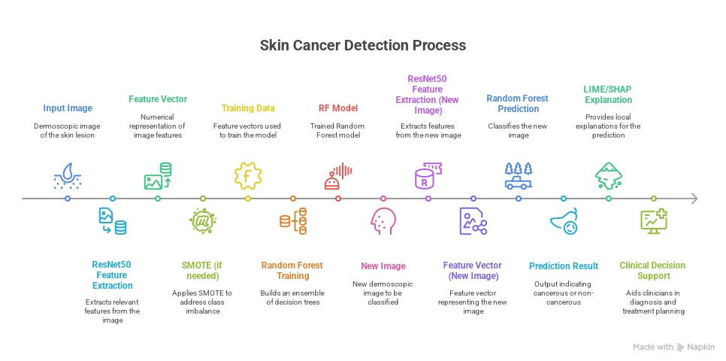

Slide 42
Results
1) ResNet50 Deep Features + Metadata → 32,771 Features :-
used a pre-trained ResNet50 model (a deep convolutional neural network) to extract deep image features from each skin lesion image.
These features are high-level, abstract representations learned by the network (e.g., texture, edges, lesion shape).
2) PCA Reduced to 50 Principal Components :-
Having 32,771 features is computationally expensive and can lead to overfitting.
So applied Principal Component Analysis (PCA) — a dimensionality reduction technique.
Selected the top 50 principal components, reducing dimensionality while retaining significant information.

Slide 43
Results
3) PCA Top Variance Contribution :-
[0.084, 0.060, 0.054, 0.046, 0.030, …]
This list shows how much variance (information) each principal component captures.
For example:
PC1 explains 8.4% of the total data variance,
PC2 explains 6.0%, and so on.
4) Applied SMOTE to Fix Class Imbalance :-
The dataset likely had unequal class distribution (some lesion types had fewer samples).
Used SMOTE (Synthetic Minority Oversampling Technique)
After applying SMOTE, each of the 7 classes had exactly 1,337 samples, creating a perfectly balanced dataset.

Slide 44
Classes (Skin Lesion Types):
Lesion Category | Label | Full Name
0 | akiec | Actinic keratoses and intraepithelial carcinoma
1 | bcc | Basal cell carcinoma
2 | bkl | Benign keratosis-like lesions
3 | df | Dermatofibroma
4 | mel | Melanoma
5 | nv | Melanocytic nevi
6 | vasc | Vascular lesions

Slide 45
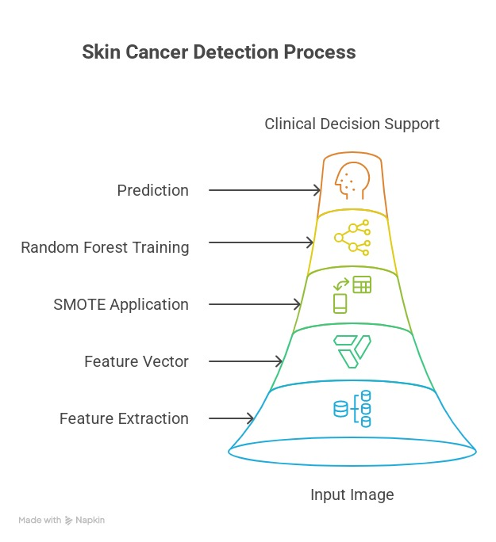
Results based on Training Models

Slide 46
Results based on Training Models
1) Random Forest :-
Random Forest Classification Report:
Lesion Category | Precision | Recall | f1-score | support
0 | 1.00 | 1.00 | 1.00 | 1341
1 | 0.98 | 1.00 | 0.99 | 1341
2 | 0.95 | 0.98 | 0.96 | 1341
3 | 1.00 | 1.00 | 1.00 | 1341
4 | 0.95 | 0.98 | 0.97 | 1341
5 | 0.97 | 0.89 | 0.93 | 1341
6 | 1.00 | 1.00 | 1.00 | 1341

Slide 47
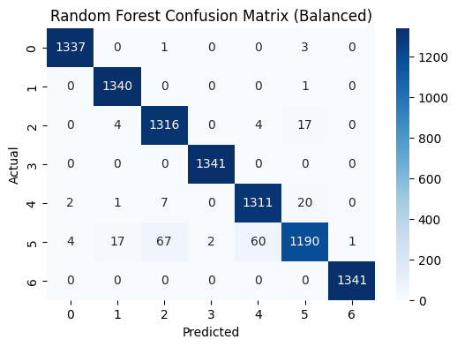
 | Precision | Recall | f1-score | support
accuracy | - | - | 0.98 | 9387
macro avg. | 0.98 | 0.98 | 0.98 | 9387
weighted avg. | 0.98 | 0.98 | 0.98 | 9387
Each row = actual (ground truth) class
Each column = predicted class
Diagonal values = correct predictions
Off-diagonal values = misclassifications

Slide 48
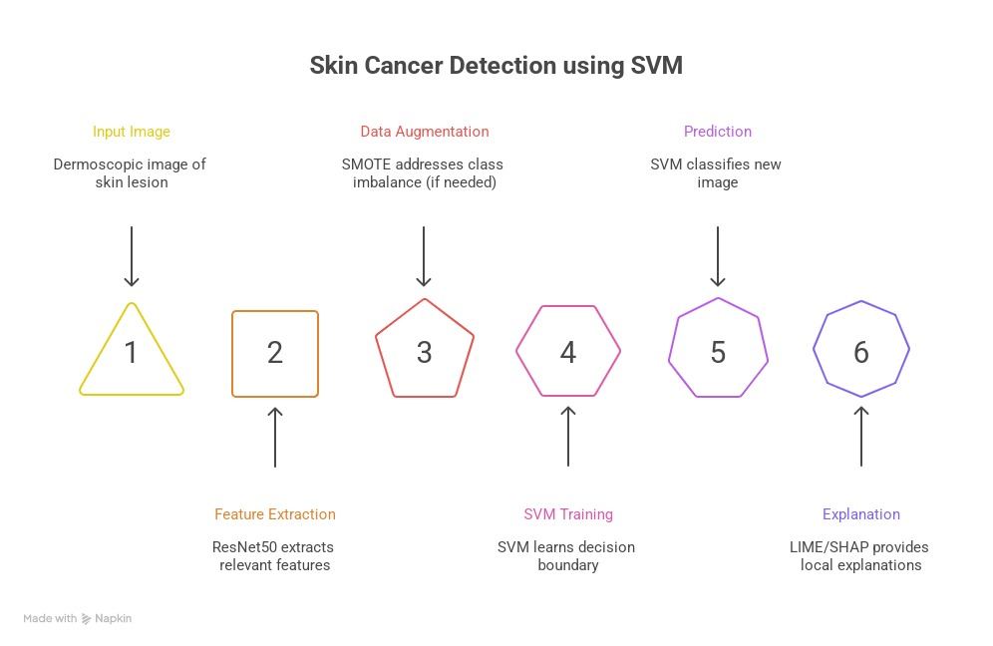
Results based on Training Models

Slide 49
Results based on Training Models
2) Support Vector Machine (SVM) :-
SVM Classification Report:
Lesion Category | Precision | Recall | f1-score | support
0 | 0.98 | 1.00 | 0.99 | 1341
1 | 0.97 | 1.00 | 0.98 | 1341
2 | 0.95 | 0.94 | 0.95 | 1341
3 | 1.00 | 1.00 | 1.00 | 1341
4 | 0.92 | 0.96 | 0.94 | 1341
5 | 0.96 | 0.88 | 0.91 | 1341
6 | 1.00 | 1.00 | 1.00 | 1341

Slide 50
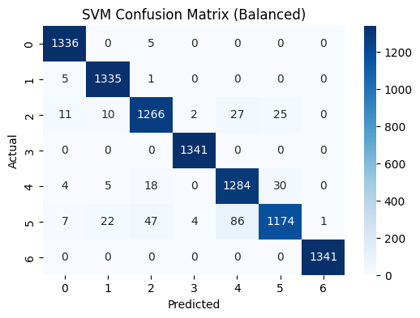
 | Precision | Recall | f1-score | support
accuracy | - | - | 0.97 | 9387
macro avg. | 0.97 | 0.97 | 0.97 | 9387
weighted avg. | 0.97 | 0.97 | 0.97 | 9387
Each row = actual (ground truth) class
Each column = predicted class
Diagonal values = correct predictions
Off-diagonal values = misclassifications

Slide 51
Results based on Training Models
3) Logistic Regression :-
Logistic Regression Classification Report:
Lesion Category | Precision | Recall | f1-score | support
0 | 0.74 | 0.77 | 0.76 | 1341
1 | 0.77 | 0.78 | 0.78 | 1341
2 | 0.68 | 0.64 | 0.66 | 1341
3 | 0.86 | 0.91 | 0.89 | 1341
4 | 0.67 | 0.67 | 0.67 | 1341
5 | 0.79 | 0.72 | 0.75 | 1341
6 | 0.96 | 0.99 | 0.98 | 1341

Slide 52
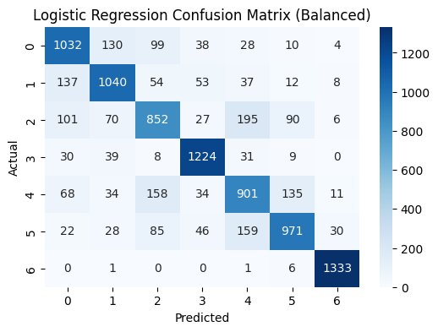
 | Precision | Recall | f1-score | support
accuracy | - | - | 0.78 | 9387
macro avg. | 0.78 | 0.78 | 0.78 | 9387
weighted avg. | 0.78 | 0.78 | 0.78 | 9387
Each row = actual (ground truth) class
Each column = predicted class
Diagonal values = correct predictions
Off-diagonal values = misclassifications

Slide 53
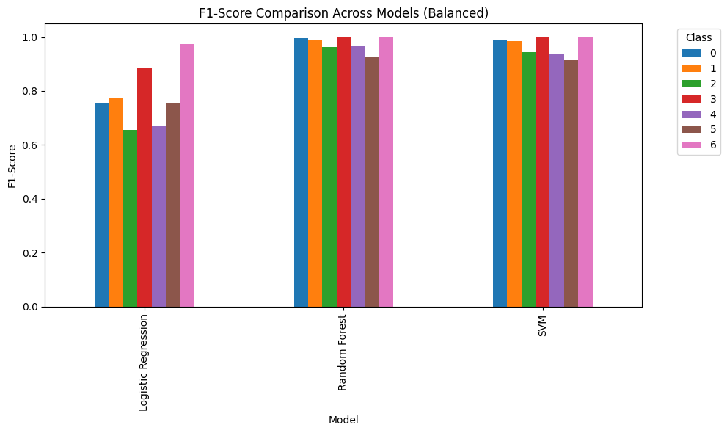

Slide 54
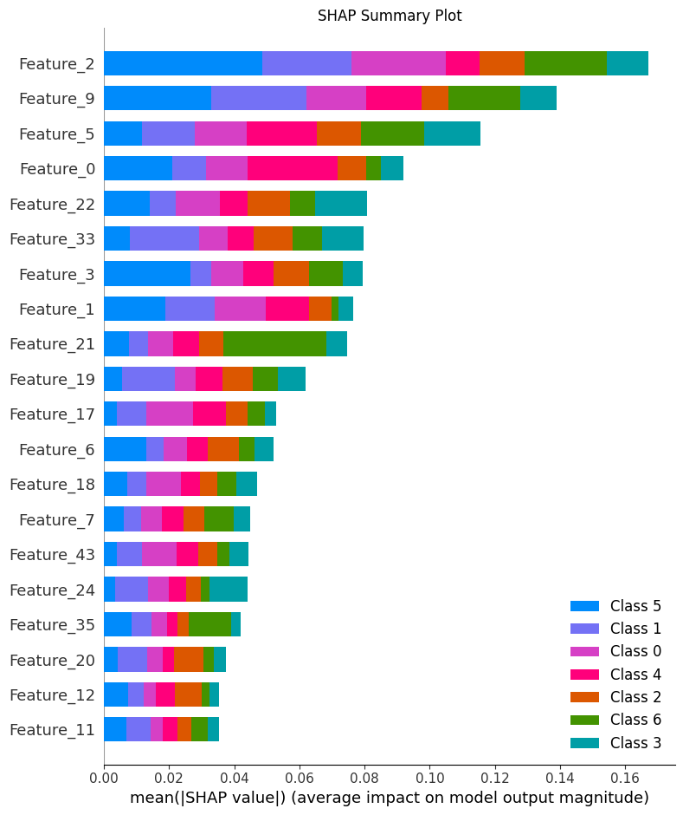
SHAP Summary Plot (Global Explainability) :-
All top 20 features shown in the image are PCA components of ResNet50 deep features, meaning your model is primarily relying on visual lesion characteristics (e.g., shape, texture, border) learned by the CNN.
Top Influential Features: Feature_2, Feature_5, Feature_9
SHAP value shows contribution per class
Used for model transparency and fairness

Slide 55
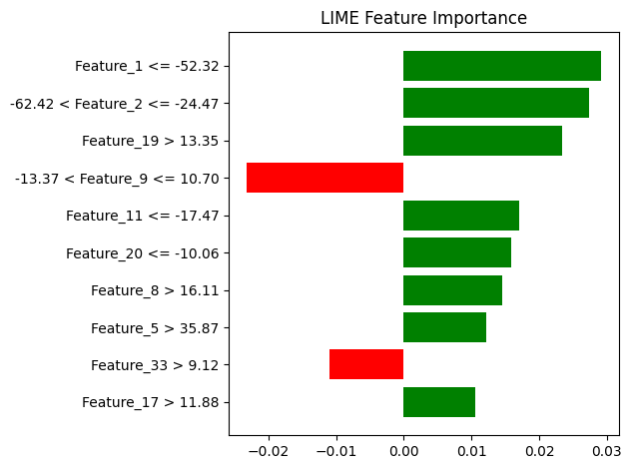
LIME Local Feature Importance :-
Just like with SHAP, all LIME-highlighted features are from PCA-reduced deep features (from ResNet50).
Explains a single prediction
Positive contribution (green) and negative (red)
Top features: Feature_1, Feature_2, Feature_19

Slide 56
References
Useful Website:-
Cleveland Clinic,
IBM
NIH National Library of Medicine, U.S Gov.
References:-
1) Evaluating the Generalizability of Support Vector Machine for Breast Cancer Detection by Oluwaseyi Ezekiel Olorunshola, Okeh Dominic Ebuka and Adeniran Kolade Ademuwagun
2) Machine Learning Algorithms For Breast Cancer Prediction And Diagnosis by Mohammed Amine Naji, Sanaa El Filali, Kawtar Aarika, EL Habib Benlahmar, Rachida Ait Abdelouhahid, Olivier Debauche
3) "A Logistic Regression Model Based on the National Mammography Database Format to Aid Breast Cancer Diagnosis",
by Jagpreet Chhatwal et al., published in American Journal of Roentgenology (April 2009; vol. 192, issue 4: pages 1117–1127; DOI: 10.2214/AJR.07.3345)

Slide 57
References
4) Polytomous Logistic Regression Based Random Forest Classifier for Diagnosing Cancer Disease
Suganthi Jeyasingh1* and Malathy Veluchamy2
5) Breast Cancer Prediction Based on Multiple Machine Learning Algorithms by Sheng Zhou ¹, Chujiao Hu ², Shanshan Wei ¹, Xiaofan Yan
6) Giaquinto AN, Sung H, Miller K, et al. Breast cancer statistics, 2022. CA Cancer J Clin. 2022;72(6):524-541. [DOI] [PubMed] [Google Scholar]
7) Global cancer statistics 2022: GLOBOCAN estimates of incidence and mortality worldwide for 36 cancers in 185 countries by Freddie Bray BSc, MSc, PhD, Mathieu Laversanne MSc, Hyuna Sung PhD, Jacques Ferlay ME, Rebecca L. Siegel MPH, Isabelle Soerjomataram MD, MSc, PhD, Ahmedin Jemal DVM, PhD

Slide 58
References
8) Detection with SVM, RF, kNN
“Detection of Skin Cancer Using SVM, Random Forest and kNN Classifiers” (J Med Syst, 2019).
Features: shape, ABCD rule, GLCM; segmentation via watershed. Found SVM performed best
9) Hybrid CNN + Metadata + ML
“Enhanced skin cancer diagnosis: deep feature extraction framework” (Frontiers in Medicine, 2024).
Hybrid models combining CNN with SVM, RF, LR, and metadata from patient info achieved ≥5% performance boost
10) Meta-learning & transfer learning advances
“Advancements in skin cancer classification: review of ML techniques” (2024).
Highlights multi-stage feature fusion, pre-trained networks + SVM ensembles achieving >96% accuracy on ISIC

Slide 59
Thank You!

